Slide 1
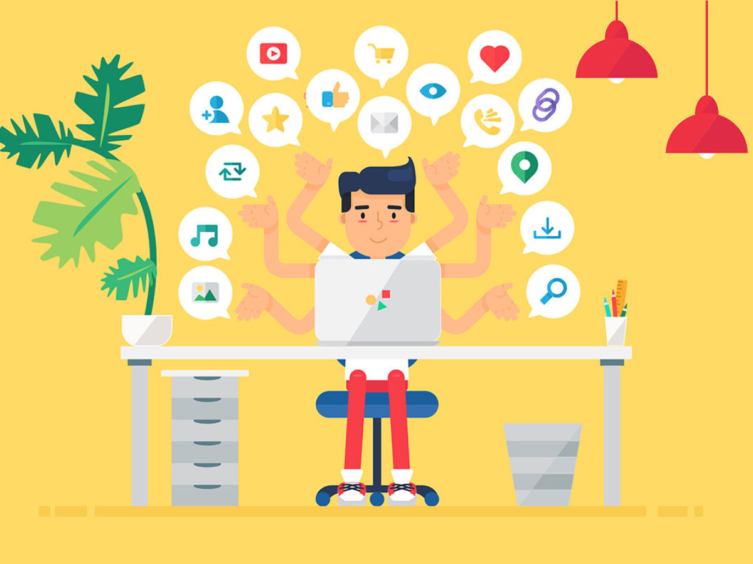
Inbound Marketing for Brained
Submitted to: Dr. Ray Titus
Submitted by: Group 1
Aruza, Renu Sree , Pearly, Ujjwal, Pallav

Slide 2

Company Overview

Slide 3
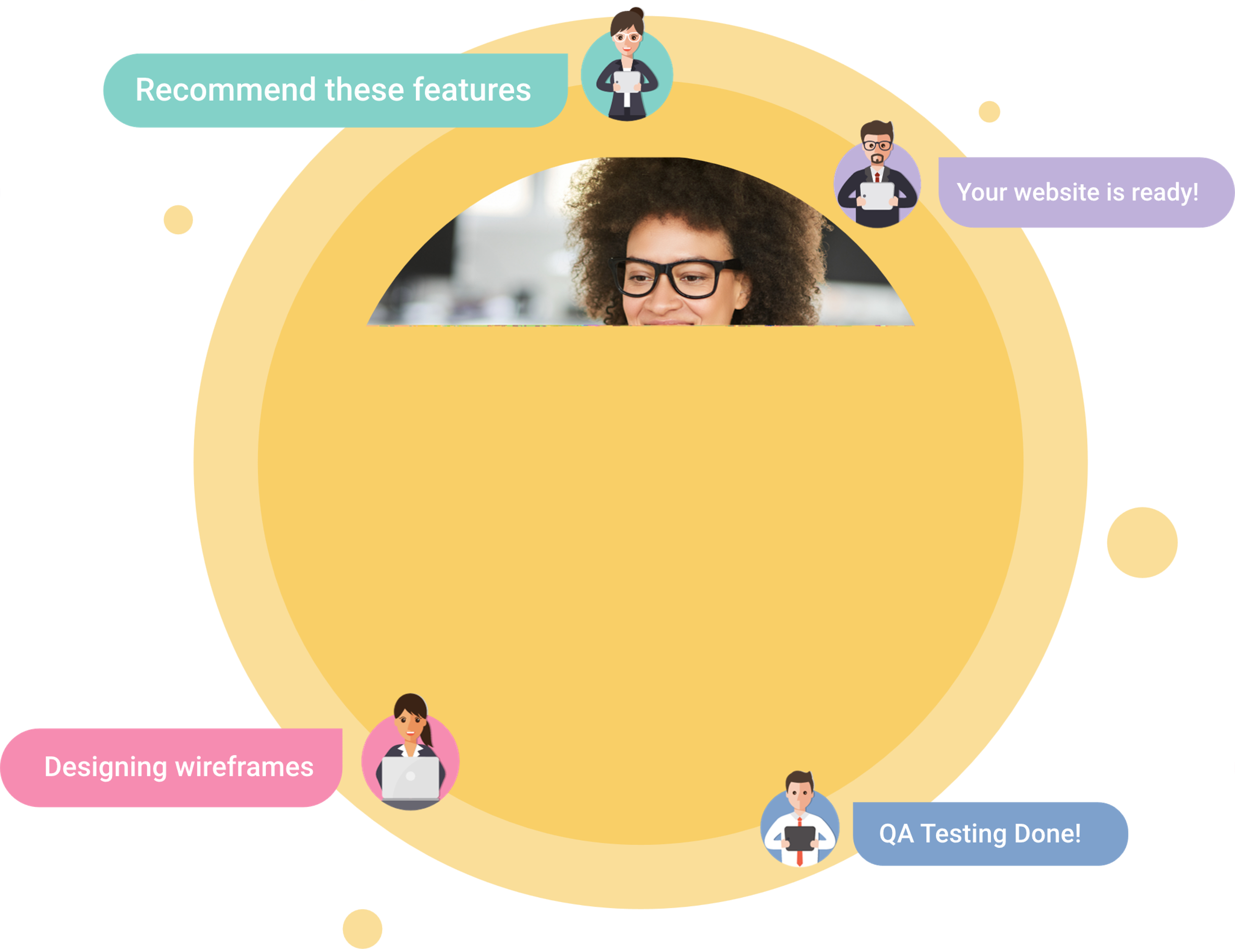
BRAINED
Helping Business Build Technology, The Smart Way.
Ruling out dependencies on expensive agencies and inexperienced freelancers, Brained has invented a platform that empowers digitally transforming businesses with affordable and accessible Tech Teams
Custom Website & Apps for different product suites:
E-Commerce
E-Learning
Social
OTT
Food & Delivery
Health & Fitness

Slide 4
Buyer’s Persona

Slide 5

Buyer’s Persona Windsor Food Factory

Slide 6
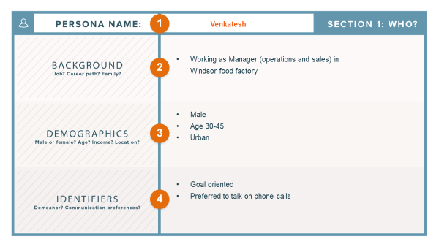

Slide 7
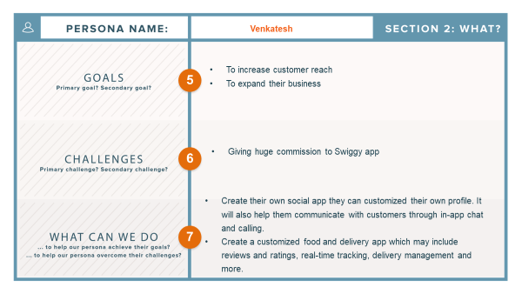

Slide 8
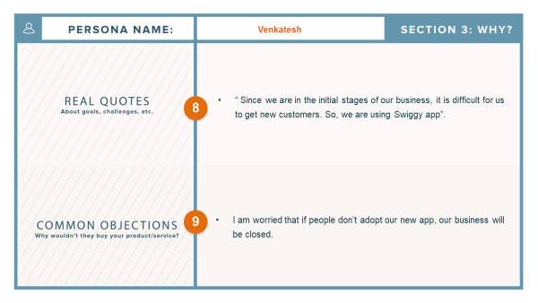

Slide 9
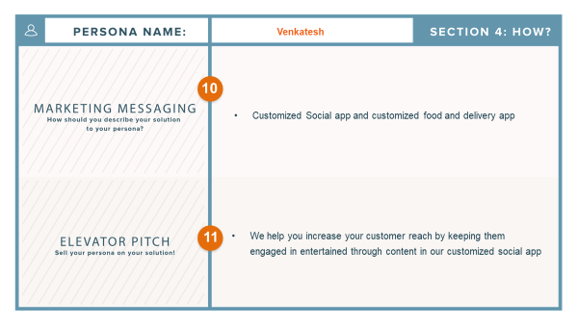

Slide 10

Buyer’s Persona Pizza on My Plate

Slide 11
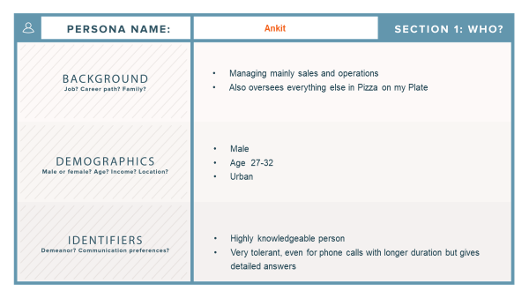

Slide 12
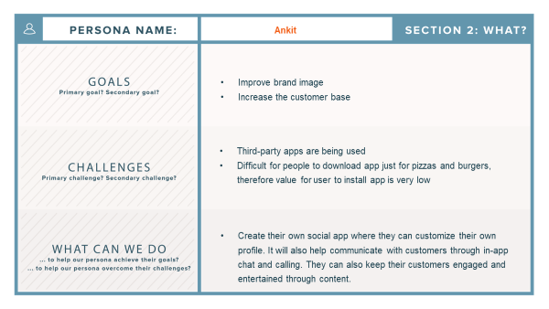

Slide 13
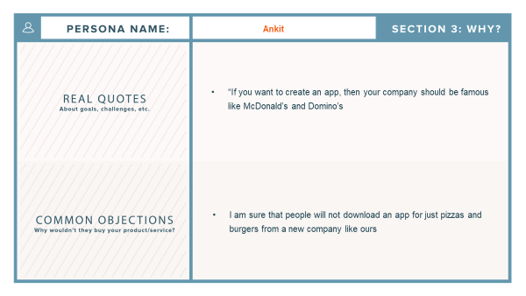

Slide 14
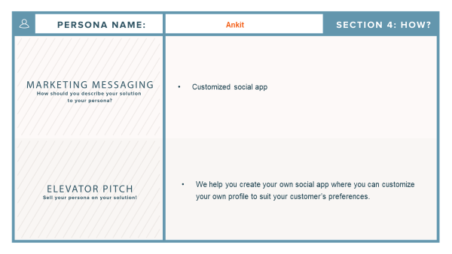

Slide 15
Buyer’s Journey

Slide 16
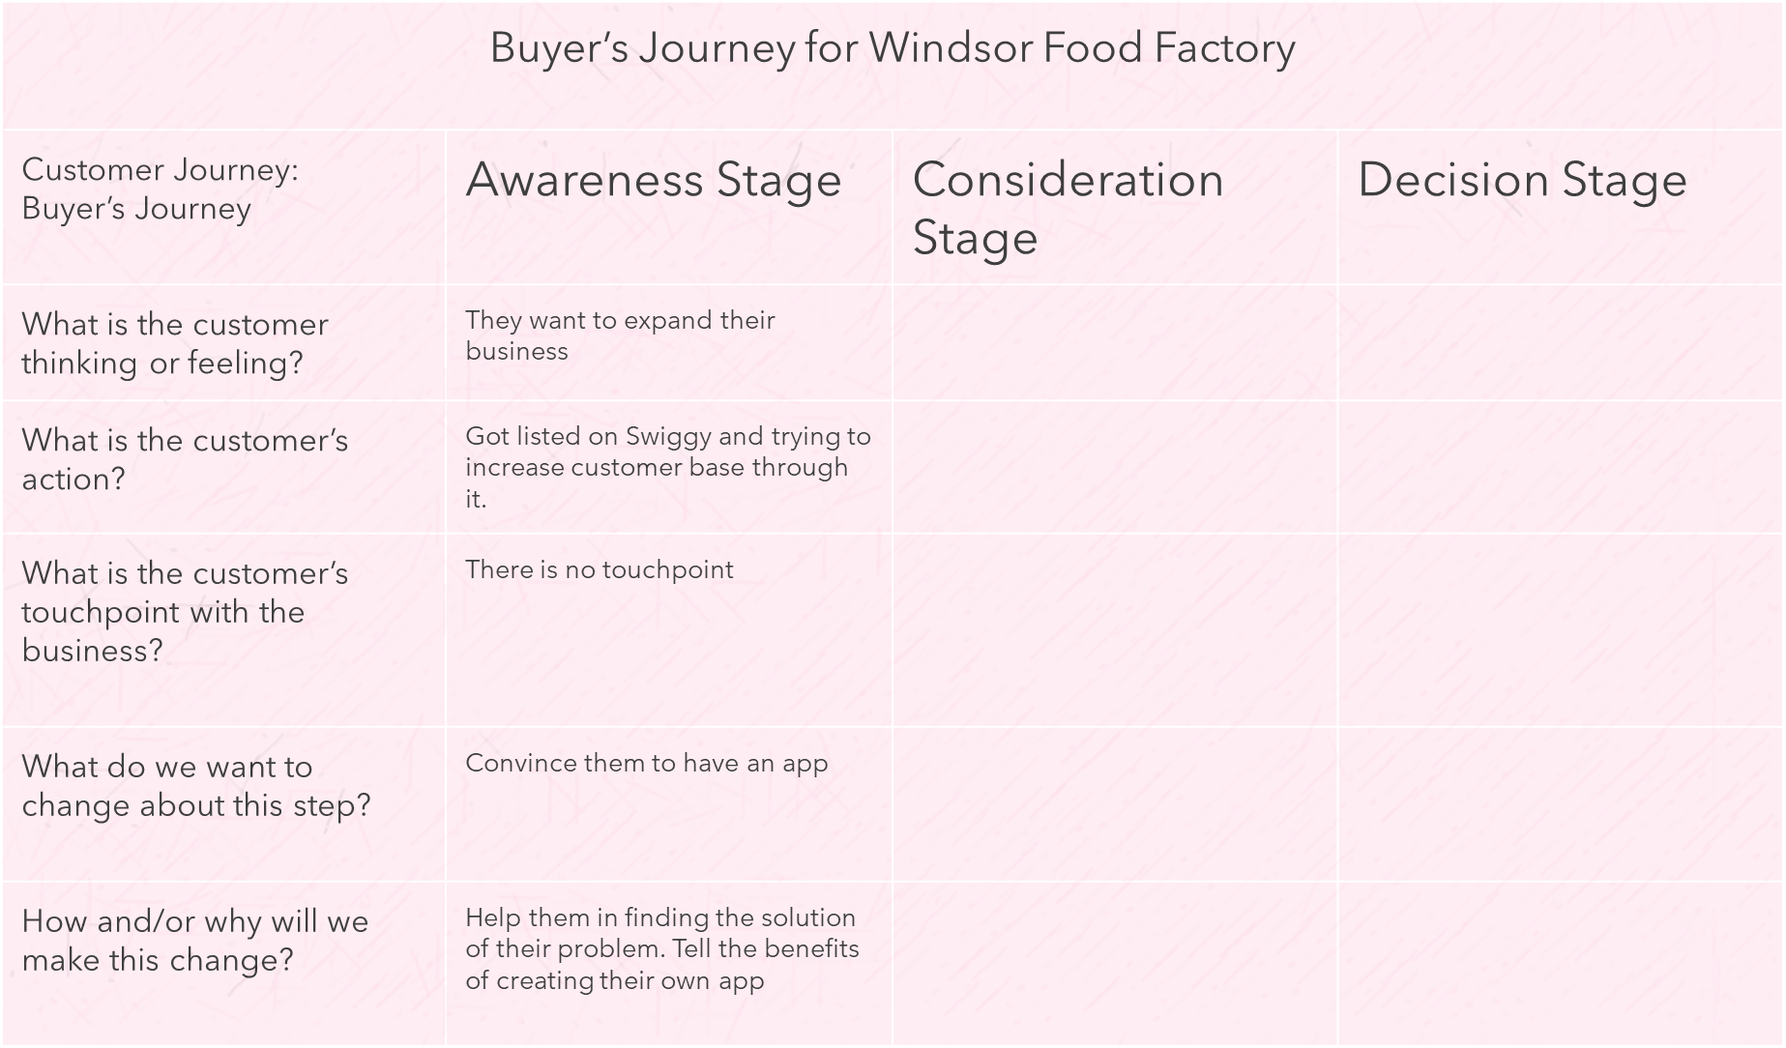

Slide 17
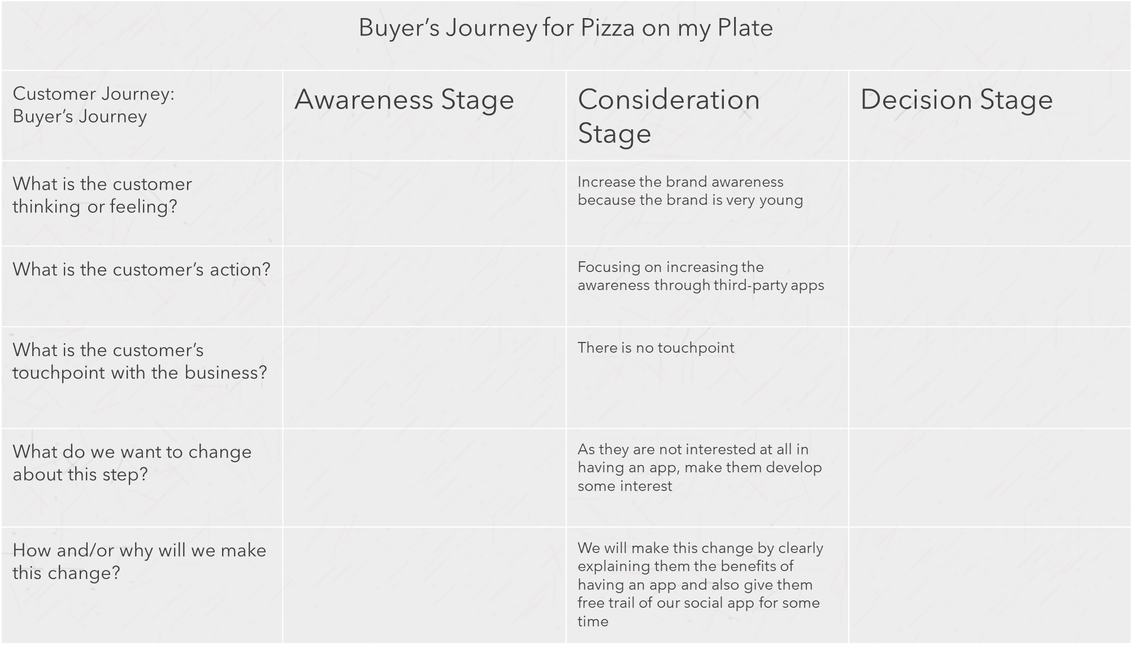

Slide 18
Keywords from Word Tracker

Slide 19
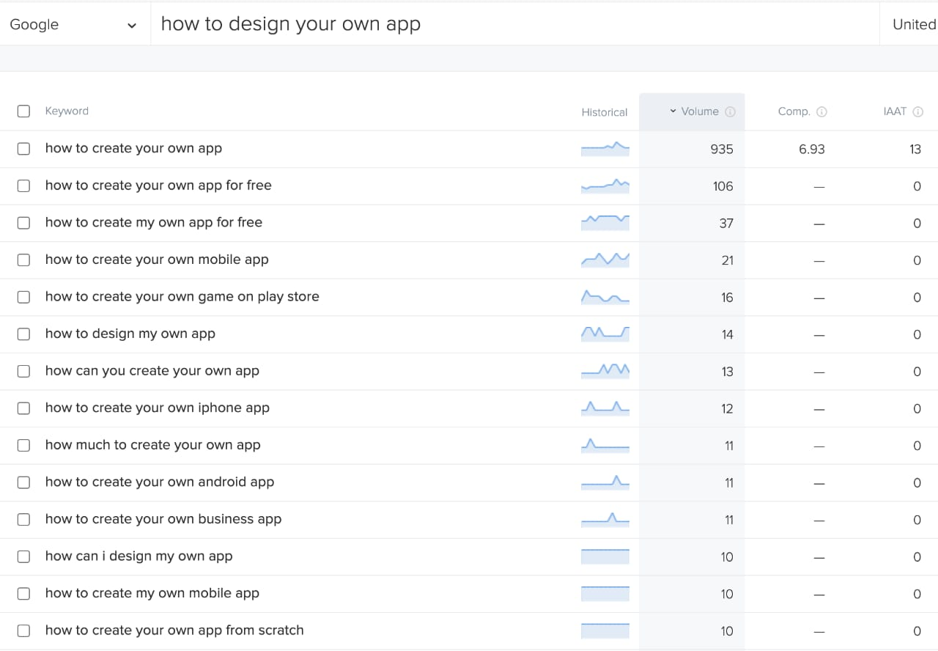
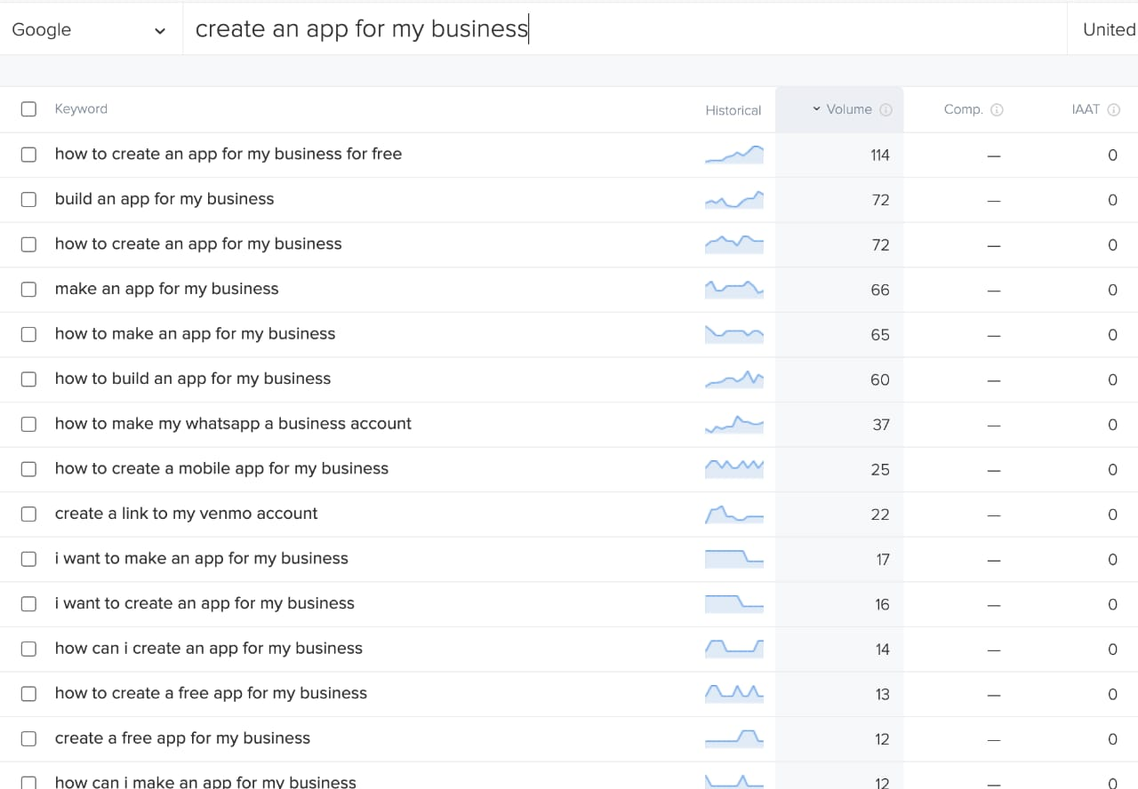
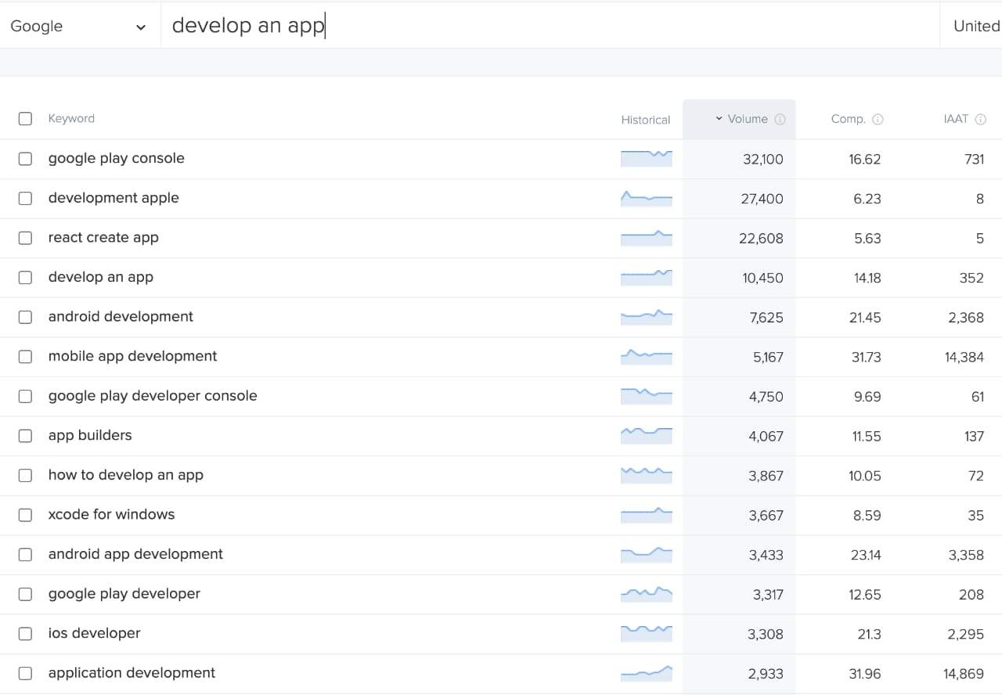

Slide 20
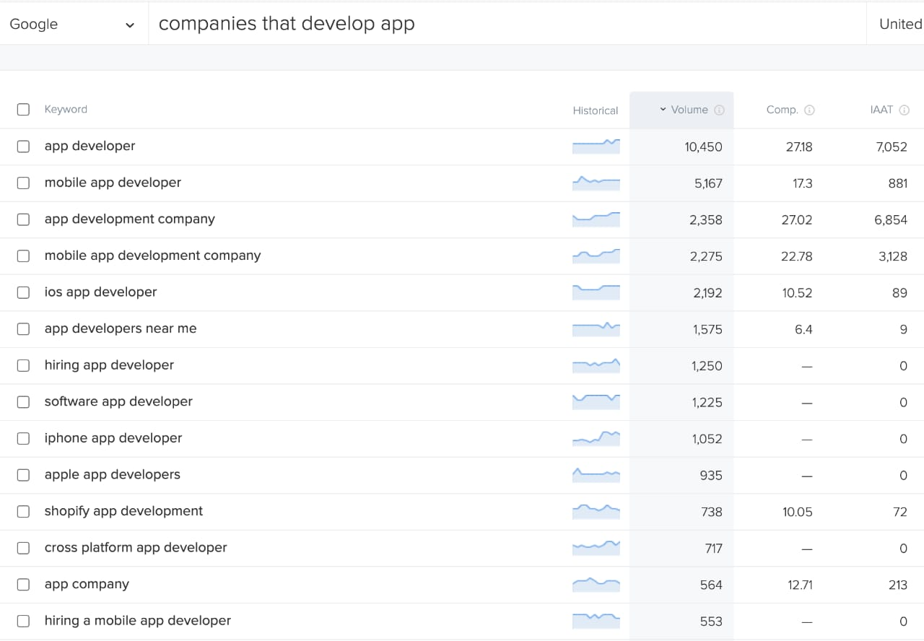
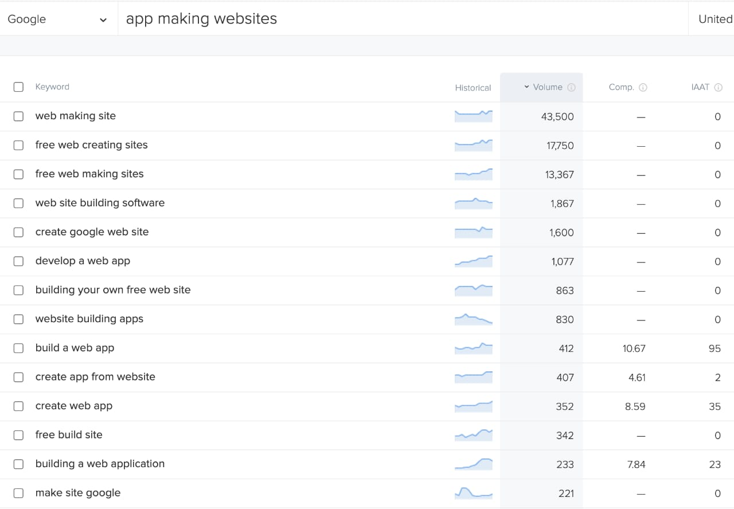
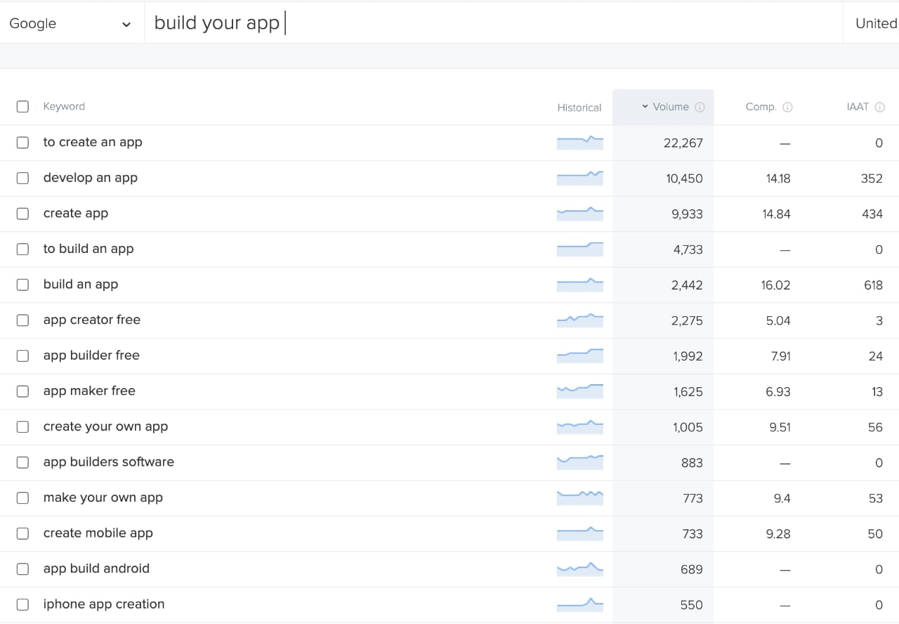

Slide 21

Brained Blog

Slide 22
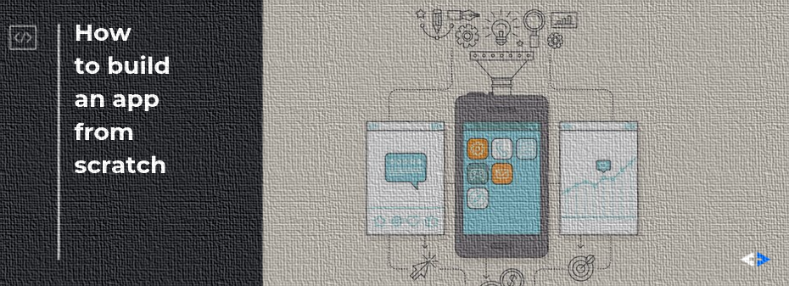
No Code App Builder 2022: Affordable one-stop solution for creating your app
If you’re not sure why you should build an app for your business, below are the 5 benefits of creating one.

Slide 23
Direct Communication and Engagement with Customers
An app improves direct communication with clients and customers because it gives access to a wealth of information with just a touch of a button. This information is very valuable because it shows the shopping behavior and buyers’ persona, which will help develop marketing strategies.
Build Brand Recognition
Think of an app as a new advertising platform for your business, where it can communicate whatever, you want for your brand to get more exposure. Create an app that has features your customers will love, while at the same time is well branded and beautifully designed.
The more customers get involved with your app the sooner they will be inclined to buy your product or service

Slide 24
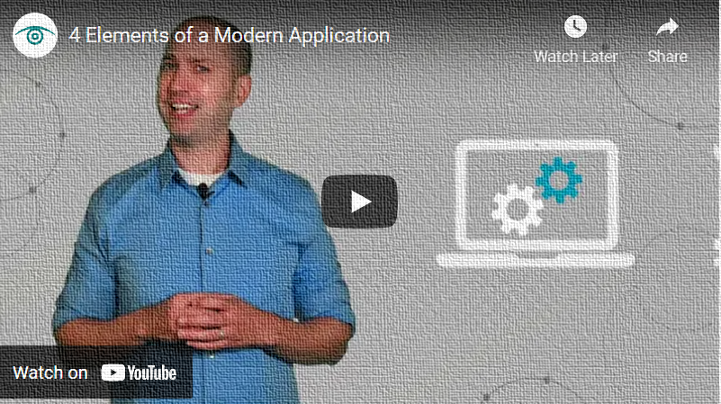
Improve Customer Engagement
Your customers always need a way to get in touch with you or communicate with you. For example, if the customer wants to know more information regarding their order or if they want to file a complaint. An app makes communicating with the customers easy because the customer can receive a quick response to the concern and are less likely to leave a bad review.
4 elements why to build your app
https://youtu.be/Xr9agFpAtPQ

Slide 25
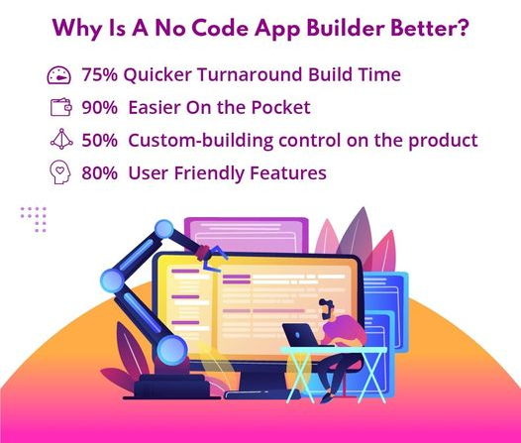
10x faster virtual tech team and cost-effective

Slide 26
Create an Effective Loyalty Programme
A loyalty program such as a reward system, where the customers are rewarded for their spending. An app is a much easier and quicker process for them to get their rewards because of which they are more likely to come back.
Create a Direct Marketing Channel
One of the biggest benefits of having a nap is providing your customers with all the information that you want such as special sales and promotions. You can easily remind your customers about your products and services through push notifications.
Now that you know some of the benefits of having your app, the next step is how to get started?
We at Brained develop customized apps for your business. Be it in Health and Fitness business, Food and Delivery, E-Learning, or E-Commerce, we are here to create an app for you!

Slide 27
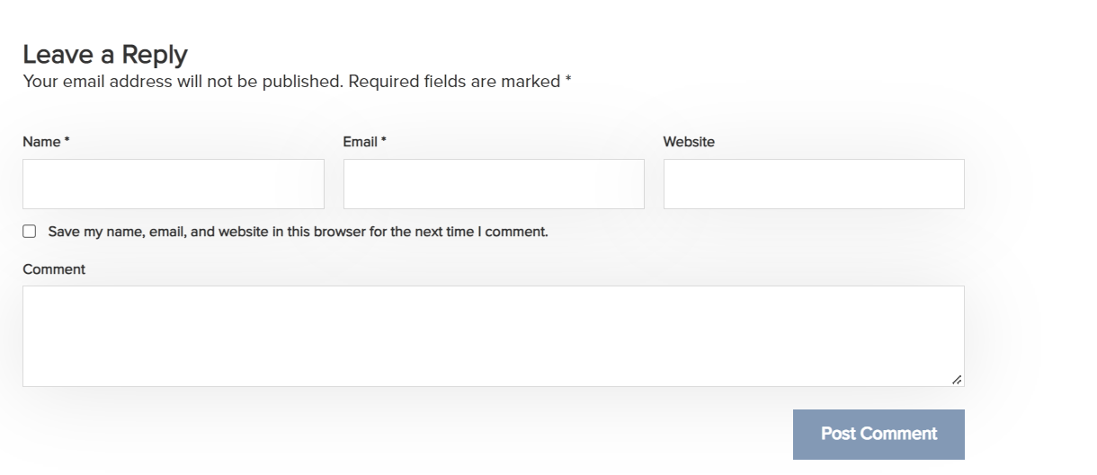

Slide 28
Landing Page

Slide 29
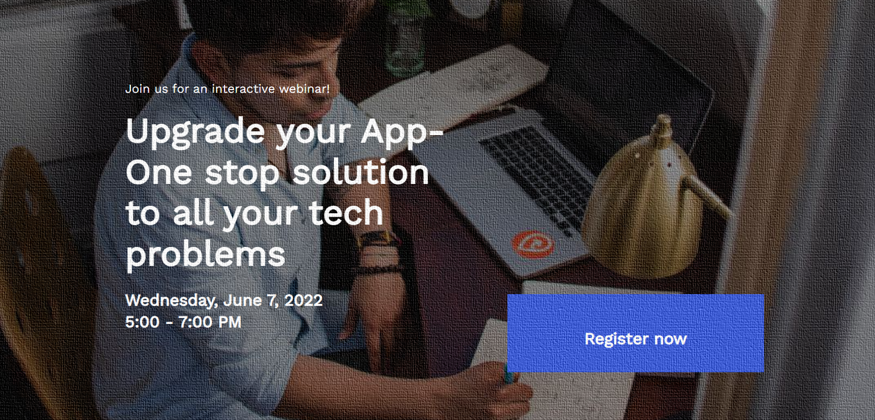

Slide 30
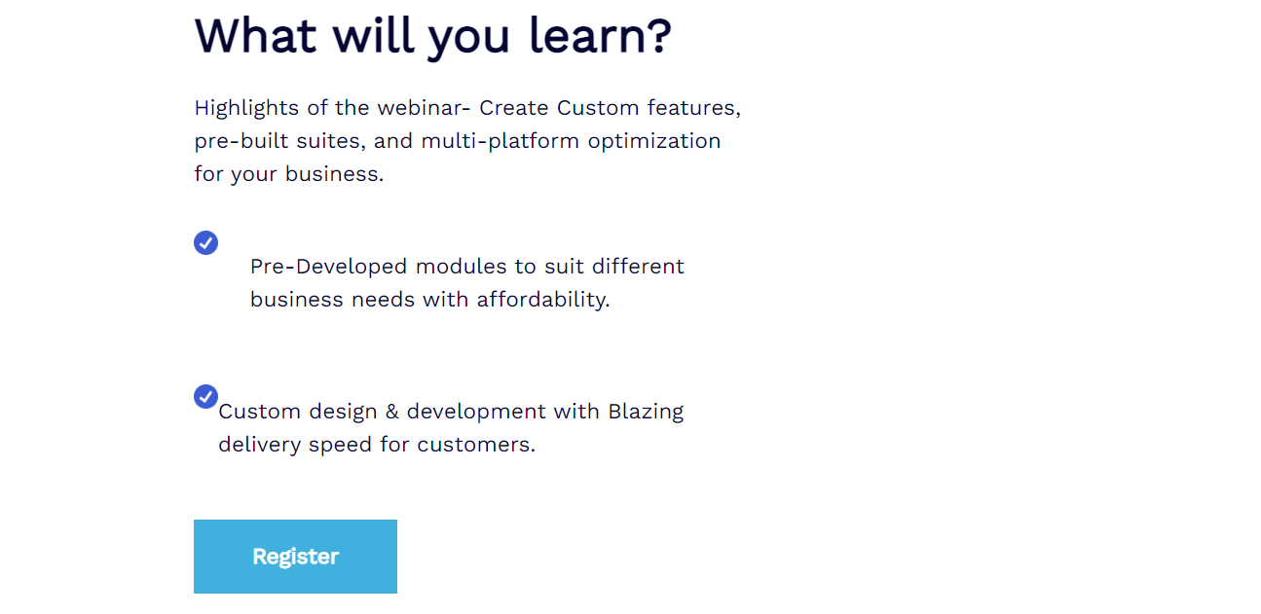
“Limited seats only WEBINAR”

Slide 31
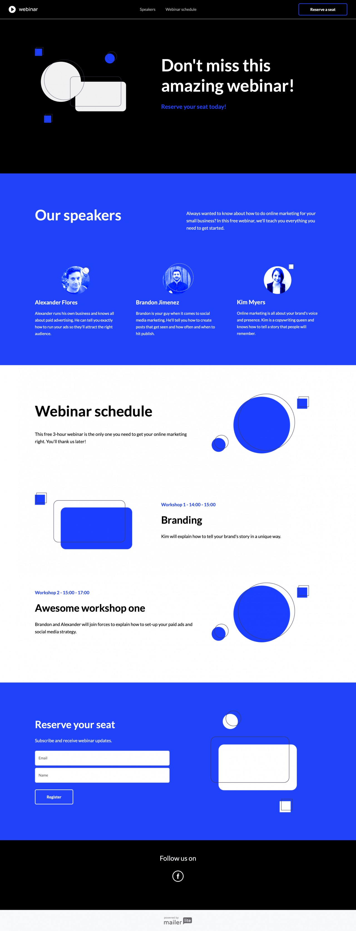

Slide 32
ThankYouPage

Slide 33
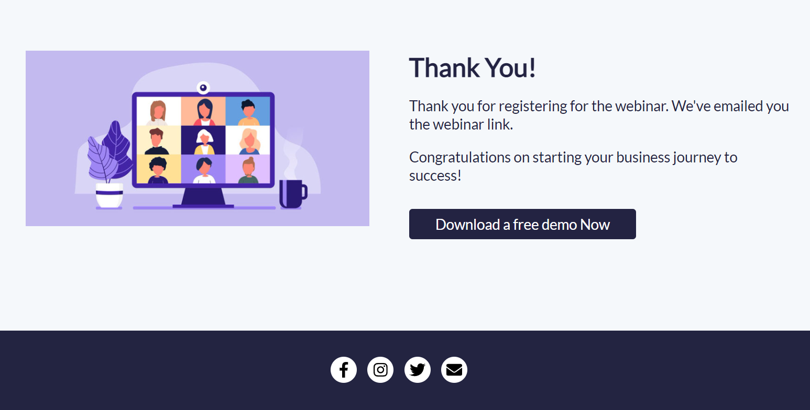
https://brained-21938679.hubspotpagebuilder.com/-temporary-slug-1088d48d-bcd2-4e48-aed8-8ef6594d3067?hs_preview=girKcQAj-73151602819

Slide 34

Email

Slide 35
Subject: How do you increase the reach of your business through a No-Code App builder?
Hey Zain!
Still, wasting a lot of money on third-party apps to increase customer reach?
A new business especially in its nascent stage can run into many challenges, such as financing, marketing, and most importantly technology. In today’s technologically driven atmosphere, being handicapped in technical areas can be crippling for new businesses.
You’ve tried everything.
Still getting tough to get your business tech-enabled with ease of access to multiple functions with a one-stop solution to all problems and assistance in support to understand the complex tech challenges.
Creating an app through a third party creates lots of technical challenges and maintenance costs that keep on increasing.
Why paying money to third-party apps is a waste?
Less flexibility to customize to your requirements
You’re inevitably dependent on the provider.
Risk of rising costs
You want to increase the reach of your business through a No-Code App Builder.

Slide 36
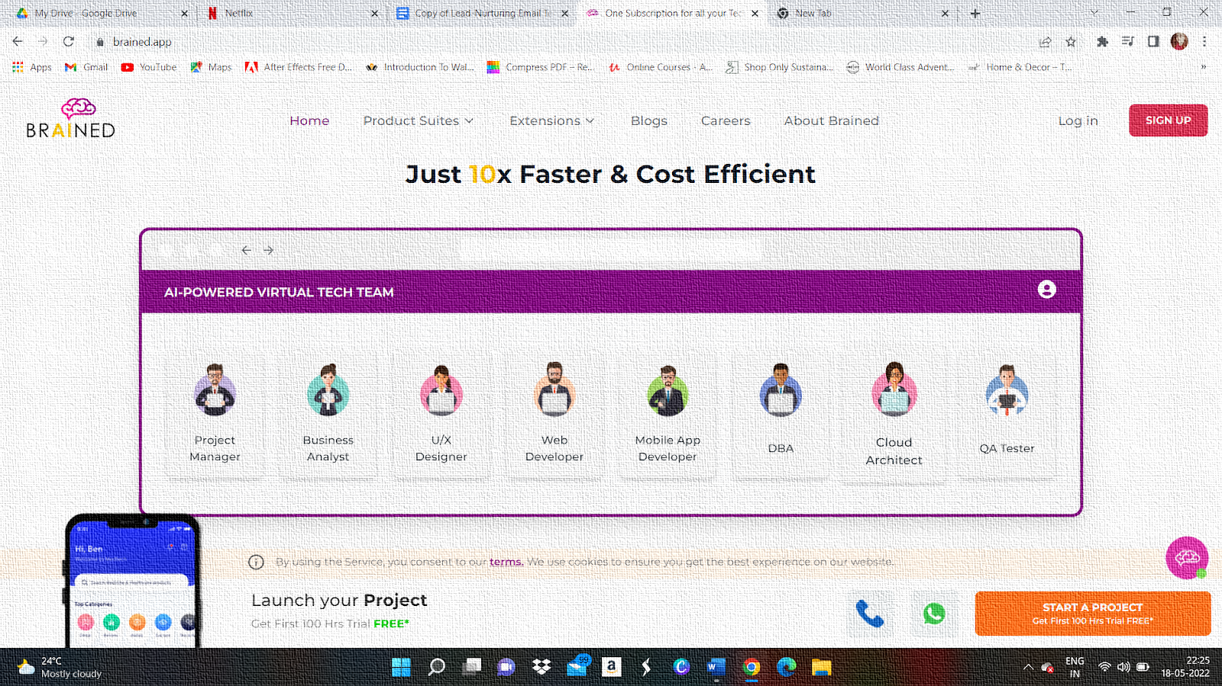
A Single Subscription for all your Tech Needs.
Taking a digital step forward is the next action plan for most organizations in recent times. With the increasingly online-first approach, more businesses are looking to grow with their mobile application. The launch tactic for your app should be based on several factors that impact your overall business strategy. The launch is critical to determining the overall success of your business plan and hence, the operational plan for the launch is important as well. With the right strategy, reaching your core target audience with specifics like demographics, geographics, and more will help your app have a substantial edge over the market

Slide 37
So, what are you waiting for? Grab the opportunity and create your own app – the most cost-effective solution available.
Okay, hang on, Let’s see the benefits of building your own app:
· Connect with your customers in a quick and easy way.
· Provide better customer service.
· Offer personalized services and instigate customer interaction.
· Develop into a stronger brand.
· No more commissions to third-party apps.
· Find valuable customer insights which will further help your business to reach new heights.

Slide 38
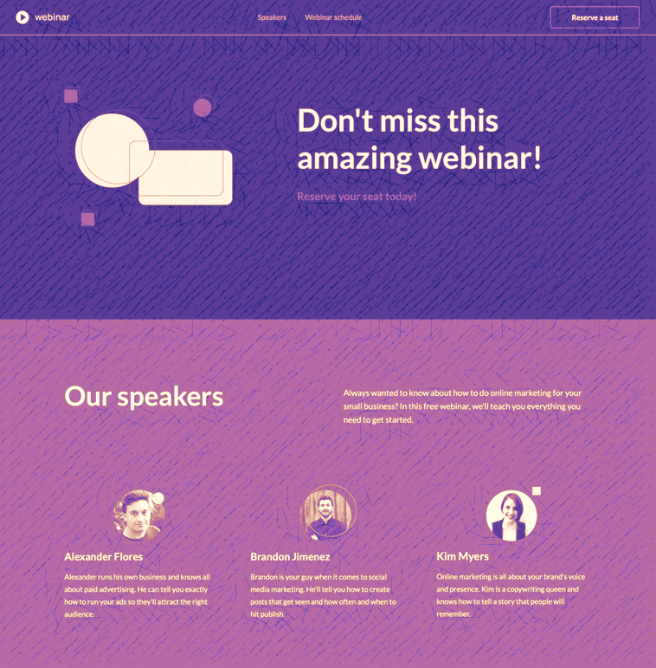
To unsubscribe click here

Slide 39
Thank You

